Slide 1
객체(Object)와 클래스(Class)

Slide 2

동기 (Motivation)
절차적 언어의 요소
변수, Primitive types와 배열(array)
문장: 대입문, 선택문, 반복문
함수 (Function or Method)
* Programming with Functions
However, these Java features are not sufficient
for developing GUI (graphical user interfaces) and large scale S/W systems.
Suppose you want to develop a GUI as shown below.
How do you program it?

Slide 3
목표 (Objectives)
§9.2 객체(object)란? 클래스(class)란?
클래스를 사용하여 객체를 모델링 하기
UML (Unified Modeling Language)
§9.3 클래스 정의(defining classes)와 객체의 생성(creating objects)
§9.4 생성자(constructor)를 사용하여 객체 생성하기
§9.5 객체참조변수(object reference variable)를 사용하여
객체에 접근하기(accessing objects)
- 참조타입(reference type)과 참조변수(reference variable)의 선언
(declaring reference variables)
- 객체 멤버 접근 연산자(object member access operator “.”)를 사용하여
객체의 데이터(멤버변수)와 멤버메소드 접근하기 (accessing object members)
- 참조 타입의 멤버 변수의 선언
- Reference type s vs. Primitive types

Slide 4
목표 (Objectives)
§9.6 Java library classes Date, Random, and Point2D
§9.7 인스턴스 멤버(instance member) vs. 정적 멤버(static member)
§9.8 Accessing private variables with get and set methods
§9.9 데이터 필드의 캡슐화(encapsulation) → Makes classes easy to maintain
§9.10 객체 실인수(object arguments) (cf) primitive-type argument
§9.11 객체와 배열
§9.12 변경되지 않는 객체(immutable object)의 생성 (note) Immutable class
§9.13 Scope of variables in the context of a class
§9.14 키워드 this : 생성 중인 객체 (in a constructor), 호출된 객체 (in a method)

Slide 5
OO Programming Concepts
Programming using objects.
An object represents an entity in the real world that can be uniquely identified.
(ex) a student, a desk, a circle, a button, a loan, …
An object has a unique identity, state, and behavior.
• The state of an object consists of a set of data fields with their current values.
• The behavior of an object is defined by a set of methods.

Slide 6

Objects
An object has both a state and behavior.
- The state defines the object,
- and the behavior defines what the object does.

Slide 7
Classes
Classes are constructs that define objects of the same type.
A Java class uses
- variables to define data fields
- and methods to define behaviors.
Additionally, a class provides a special type of methods, known as constructors,
which are invoked during construction of objects from the class.

Slide 8
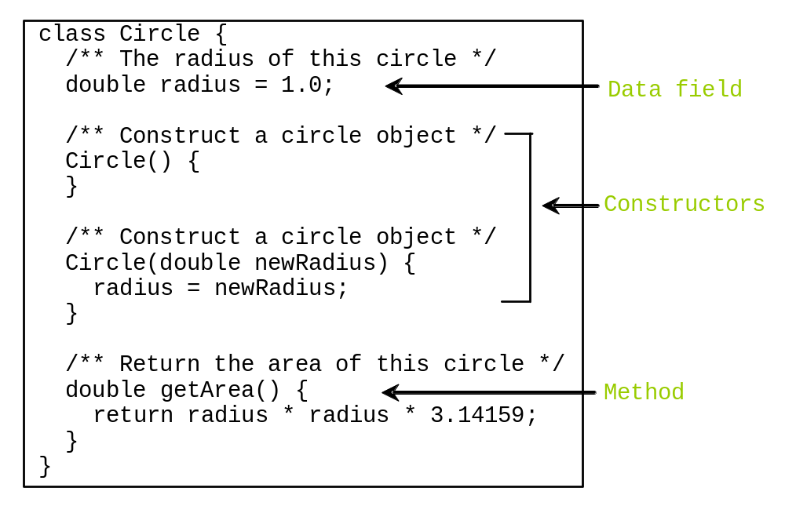
Classes

Slide 9
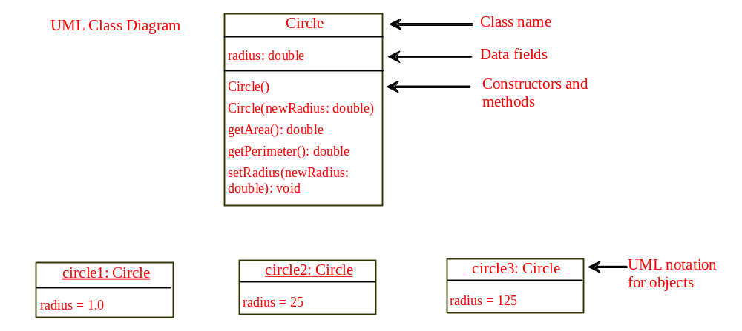
UML Class Diagram

Slide 10
Example: Defining Classes and Creating Objects
Objective: Demonstrate
- creating objects,
- accessing data,
- and using methods.
TestSimpleCircle
Run

Slide 11
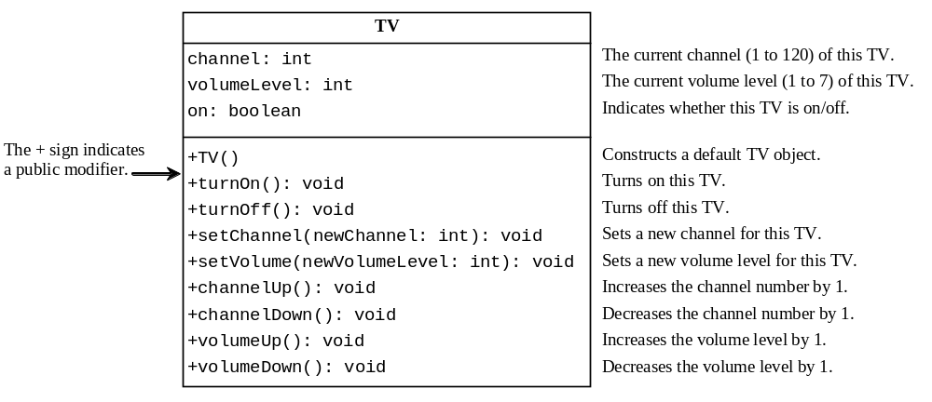
Example: Defining Classes and Creating Objects
TV
TestTV
Run

Slide 12
Constructors
Circle() {
}
Circle(double newRadius) {
radius = newRadius;
}
Constructors are a special kind of methods that are invoked to construct(initialize) objects.

Slide 13
Constructors, cont.
A constructor with no parameters is referred to as a no-arg constructor.
Constructors must have the same name as the class itself.
Constructors do not have a return type—not even void.
Constructors are invoked using the new operator when an object is created. Constructors play the role of initializing objects.

Slide 14
Creating Objects Using Constructors
new ClassName()
Example:
new Circle();
new Circle(5.0);

Slide 15
Default Constructor
A class may be defined without constructors.
In this case, a no-arg constructor with an empty body is
implicitly defined in the class.
This constructor, called a default constructor, is provided automatically
only if no constructors are explicitly defined in the class.

Slide 16
Declaring Object Reference Variables
To reference an object, assign the object to a reference variable.
To declare a reference variable, use the syntax:
ClassName objectRefVar;
Example:
Circle myCircle;

Slide 17
Declaring/Creating Objects in a Single Step
ClassName objectRefVar = new ClassName();
Example:
Circle myCircle = new Circle();
Assign object reference
Create an object

Slide 18
Accessing Object’s Members
Referencing the object’s data:
objectRefVar.data
(ex) myCircle.radius
Invoking the object’s method:
objectRefVar.methodName(arguments)
(ex) myCircle.getArea()

Slide 19
Trace Code
animation
Declare myCircle
Circle myCircle = new Circle(5.0);
Circle yourCircle = new Circle();
yourCircle.radius = 100;
myCircle
no value

Slide 20

Trace Code, cont.
animation
Circle myCircle = new Circle(5.0);
Circle yourCircle = new Circle();
yourCircle.radius = 100;
myCircle
no value
Create a circle

Slide 21
Trace Code, cont.
animation
Circle myCircle = new Circle(5.0);
Circle yourCircle = new Circle();
yourCircle.radius = 100;
myCircle
reference value
Assign object reference to myCircle

Slide 22
Trace Code, cont.
animation
Circle myCircle = new Circle(5.0);
Circle yourCircle = new Circle();
yourCircle.radius = 100;
myCircle
reference value
yourCircle
no value
Declare yourCircle

Slide 23
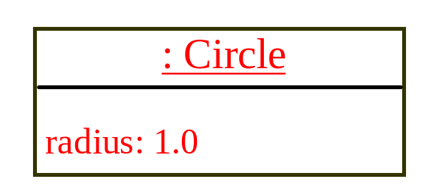
Trace Code, cont.
animation
Circle myCircle = new Circle(5.0);
Circle yourCircle = new Circle();
yourCircle.radius = 100;
myCircle
reference value
yourCircle
no value
Create a new Circle object

Slide 24

Trace Code, cont.
animation
Circle myCircle = new Circle(5.0);
Circle yourCircle = new Circle();
yourCircle.radius = 100;
myCircle
reference value
yourCircle
reference value
Assign object reference to yourCircle

Slide 25

Trace Code, cont.
animation
Circle myCircle = new Circle(5.0);
Circle yourCircle = new Circle();
yourCircle.radius = 100;
myCircle
reference value
yourCircle
reference value
Change radius in yourCircle

Slide 26
Caution
Recall that you use
  Math.methodName(arguments) (e.g., Math.pow(3, 2.5))
to invoke a method in the Math class. Can you invoke getArea() using SimpleCircle.getArea()? The answer is no. All the methods used before this chapter are static methods, which are defined using the static keyword. However, getArea() is non-static. It must be invoked from an object using
  objectRefVar.methodName(arguments) (e.g., myCircle.getArea()).
More explanations will be given in the section on “Static Variables, Constants, and Methods.”

Slide 27
Reference Data Fields
reference-type data field
(ex) Student class contains a data field name of the String type.
public class Student {
String name; // name has default value null
int age; // age has default value 0
boolean isScienceMajor; // isScienceMajor has default value false
char gender; // c has default value '\u0000'
}

Slide 28
The null Value
If a data field of a reference type does not reference any object,
the data field holds a special literal value, null.

Slide 29
Default Value for a Data Field
The default value of a data field is
null for a reference type,
0 for a numeric type,
false for a boolean type,
'\u0000' for a char type.
However, Java assigns no default value to a local variable inside a method.
public class Test {
public static void main(String[] args) {
Student student = new Student();
System.out.println("name? " + student.name);
System.out.println("age? " + student.age);
System.out.println("isScienceMajor? " + student.isScienceMajor);
System.out.println("gender? " + student.gender);
}
}

Slide 30
Example
Java assigns no default value to a local variable inside a method.
public class Test {
public static void main(String[] args) {
int x; // x has no default value
String y; // y has no default value
System.out.println("x is " + x);
System.out.println("y is " + y);
}
}
Compile error: variable not initialized

Slide 31

Primitive Type Variable vs. Object Type Variable

Slide 32

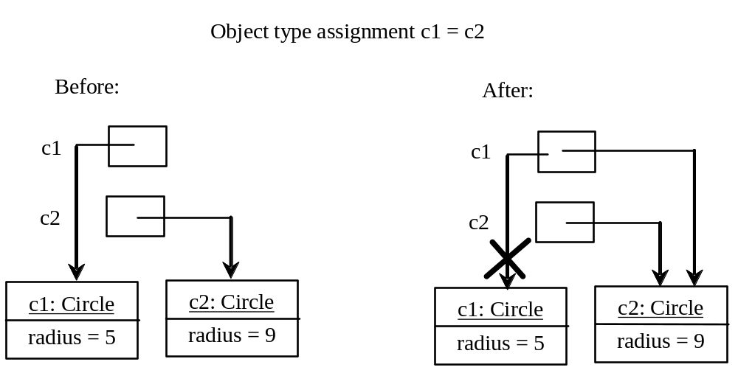
Copying Variables of
Primitive Data Types and Object Types

Slide 33
Garbage Collection
As shown in the previous figure,
after the assignment statement c1 = c2,
c1 points to the same object referenced by c2.
The object previously referenced by c1 is no longer referenced.
This object is known as garbage.
Garbage is automatically collected by JVM.

Slide 34
Garbage Collection, cont
TIP:
If you know that an object is no longer needed,
you can explicitly assign null to a reference variable for the object.
The JVM will automatically collect the space
if the object is not referenced by any variable.

Slide 35

The Date Class
Java provides a system-independent encapsulation of date and time in the java.util.Date class.
You can use the Date class to create an instance for the current date and time
and use its toString method to return the date and time as a string.

Slide 36
The Date Class Example
For example, the following code
  java.util.Date date = new java.util.Date();
  System.out.println( date.toString() );
will display a string like:
Sun Mar 09 13:50:19 EST 2003

Slide 37

The Random Class
You have used Math.random() to obtain a random double value
between 0.0 and 1.0 (excluding 1.0).
A more useful random number generator is provided
in the java.util.Random class.

Slide 38
The Random Class Example
If two Random objects have the same seed,
they will generate identical sequences of numbers.
Random random1 = new Random(3);
for (int i = 0; i < 10; i++)
System.out.print(random1.nextInt(1000) + " ");
-> 734 660 210 581 128 202 549 564 459 961
Random random2 = new Random(3);
for (int i = 0; i < 10; i++)
System.out.print(random2.nextInt(1000) + " ");
-> 734 660 210 581 128 202 549 564 459 961

Slide 39
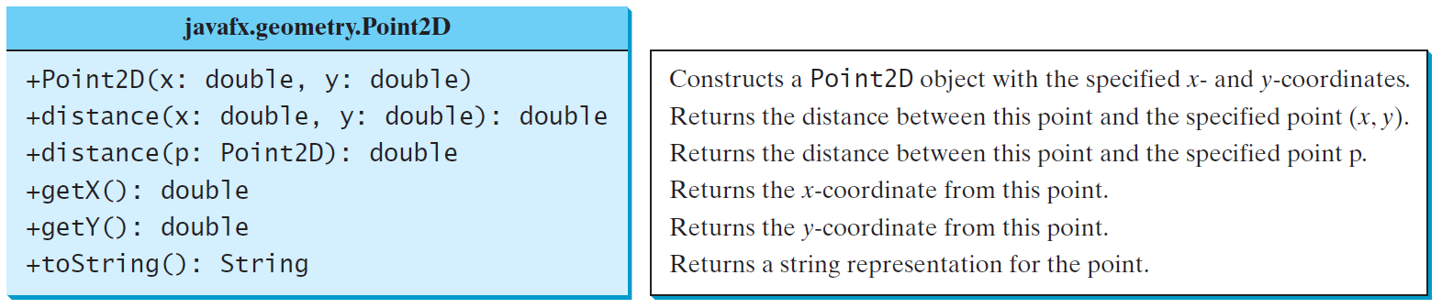
The Point2D Class
Aconveninent Point2D class in the javafx.geometry package
for representing a point in a two-dimensional plane.
TestPoint2D
Run

Slide 40
Instance Variables, and Methods
Instance variables belong to a specific instance.
Instance methods are invoked by an instance of the class.

Slide 41
Static Variables, Constants, and Methods
Static variables are shared by all the instances of the class.
Static methods are not tied to a specific object.
Static constants are final variables shared by all the instances of the class.

Slide 42
Static Variables, Constants, and Methods, cont.
To declare static variables, constants, and methods, use the static modifier.

Slide 43
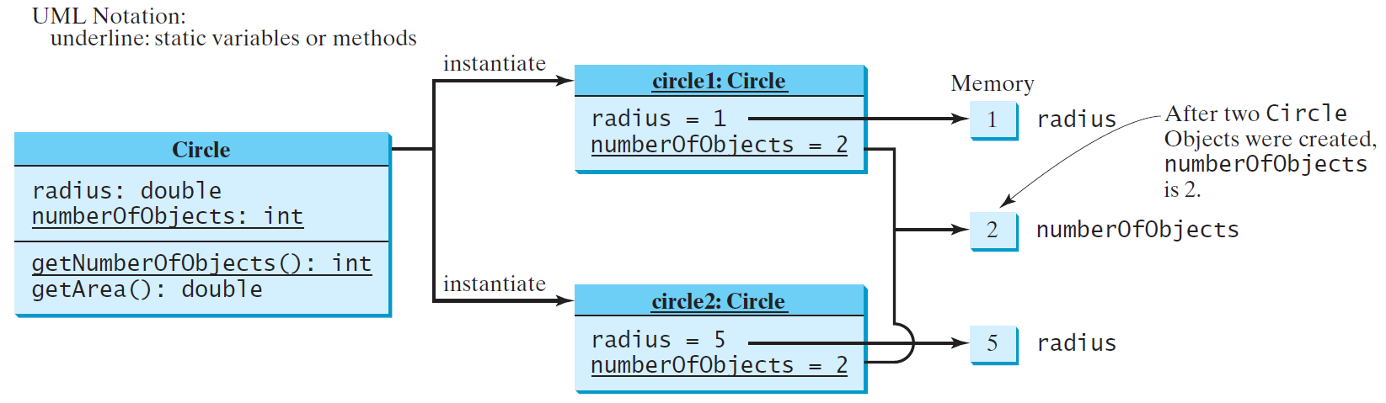
Static Variables, Constants, and Methods, cont.

Slide 44
Example of
Using Instance and Class Variables and Method
Objective: Demonstrate the roles of instance and class variables and their uses. This example adds a class variable numberOfObjects to track the number of Circle objects created.
CircleWithStaticMembers
TestCircleWithStaticMembers
Run

Slide 45
Visibility Modifiers and
Accessor/Mutator Methods
By default,
the class/variable/method can be accessed
by any class in the same package. * Package-private
Public The class/data/method is visible to any class in any package.
private The data/methods can be accessed only by the declaring class.
The get/set methods are used to read/modify private properties.

Slide 46

The private modifier restricts access to within a class,
the default modifier restricts access to within a package,
and the public modifier enables unrestricted access.

Slide 47

The default modifier on a class restricts access to within a package,
and the public modifier enables unrestricted access.

Slide 48
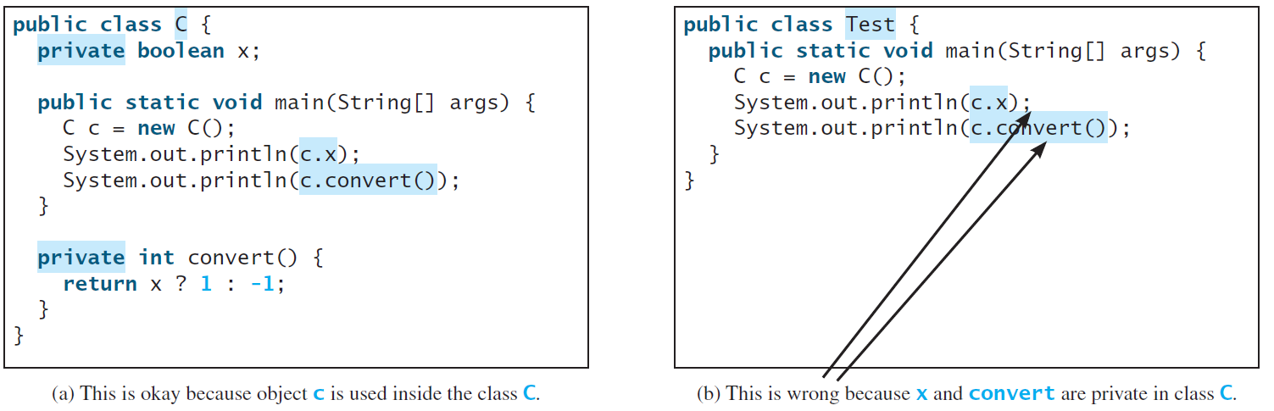
NOTE
An object cannot access its private members, as shown in (b).
It is OK, however, if the object is declared in its own class, as shown in (a).
Access modifier는 클래스 외부에 적용됨. 클래스 내부는 scope rule이 지배함.

Slide 49
Why Data Fields Should Be private?
To protect data.
To make code easy to maintain.

Slide 50

Example of
Data Field Encapsulation
CircleWithPrivateDataFields
TestCircleWithPrivateDataFields
Run

Slide 51
Passing Objects to Methods
Passing by value for primitive type value
(the value is passed to the parameter)
Passing by value for reference type value
(the value is the reference to the object)
TestPassObject
Run

Slide 52
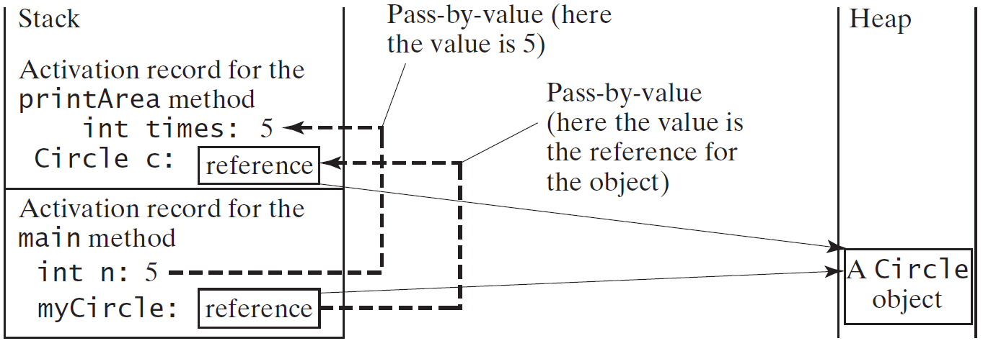
Passing Objects to Methods, cont.

Slide 53

Array of Objects
Circle[] circleArray = new Circle[10];
Actually an array of reference variables

Slide 54
Array of Objects, cont.
Summarizing the areas of the circles
TotalArea
Run

Slide 55
Immutable Objects and Classes
If the contents of an object cannot be changed once the object is created,
the object is called an immutable object
and its class is called an immutable class.
all private data fields + no mutators = not necessarily immutable
(ex) class Student has all private data fields and no mutators, but it is mutable.

Slide 56
Example
public class BirthDate {
private int year;
private int month;
private int day;
public BirthDate(int newYear,
int newMonth, int newDay) {
year = newYear;
month = newMonth;
day = newDay;
}
public void setYear(int newYear) {
year = newYear;
}
}
public class Student {
private int id;
private BirthDate birthDate;
public Student(int ssn,
int year, int month, int day) {
id = ssn;
birthDate = new BirthDate(year, month, day);
}
public int getId() {
return id;
}
public BirthDate getBirthDate() {
return birthDate;
}
}
public class Test {
public static void main(String[] args) {
Student student = new Student(111223333, 1970, 5, 3);
BirthDate date = student.getBirthDate();
date.setYear(2010); // Now the student birth year is changed!
}
}

Slide 57
What Class is Immutable?
For a class to be immutable,
it must mark all data fields private
and provide no mutator methods
and no accessor methods
that would return a reference to a mutable data field object.

Slide 58
Scope of Variables
The scope of instance and static variables is the entire class.
They can be declared anywhere inside a class.
The scope of a local variable starts from its declaration
and continues to the end of the block that contains the variable.
A local variable must be initialized explicitly before it can be used.

Slide 59
The this Keyword
The this keyword is the name of a reference that refers to an object itself.
One common use is reference a class’s hidden data fields.
Another common use is
to enable a constructor to invoke another constructor of the same class.

Slide 60

Reference the Hidden Data Fields

Slide 61

Calling Overloaded Constructor

